Slide 1
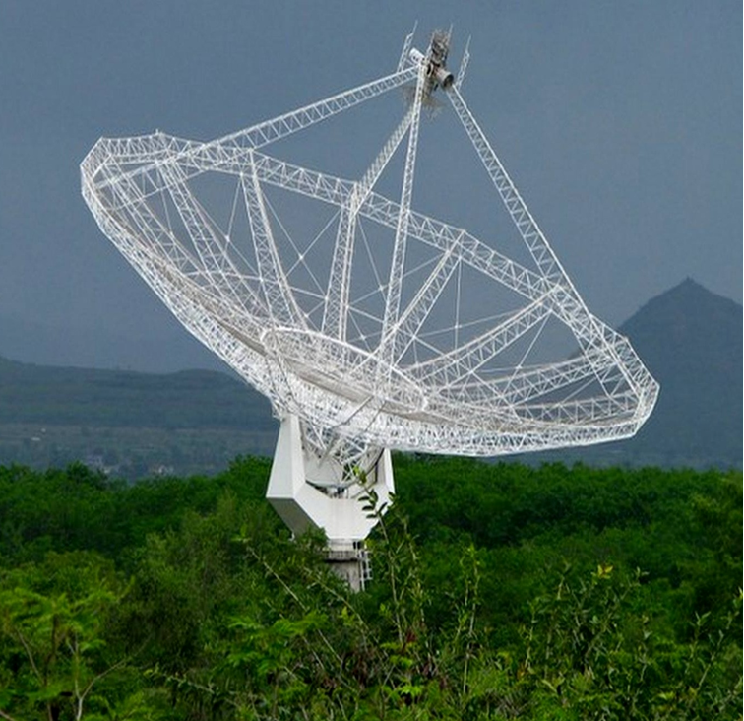


Slide 2
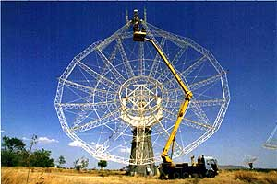
Brief description of works and responsibilities taken for the GMRT(1990-2015)
I joined TIFR for the GMRT project on 30th April 1990 at NCRA, Pune as Electronics Engineer-SC. I have taken the following responsibilities.
GMRT Front-end Receiver System (Design, development, installation and commissioning)
Involved in development of the GMRT Front-end Receiver. I have design and developed of RF Filters, Broadband RF Amplifier and Phase Switch, RF polarization changeover switch, RF Solar Attenuators, Helical antenna for polarization testing, Installation and commissioning of GMRT Front-end Receiver, Radio Frequency Interference (RFI) survey/measurements in and around the GMRT Observatory. RF Shielding measurement of GMRT antenna cages. Also I have designed and developed RFI free Telephony System for High Lift Platform (HLP)

Slide 3
GMRT Sentinel System (Design, development, installation and commissioning)
Successfully designed, developed and commissioned of world class electronics safety and security system in all the GMRT Antenna Shells. This system is providing complete safety and protection to all sensitive and costly electrical/servo/electronics sub-system from high temperature, smoke, fire, intruders etc.
GMRT Operations
At present I am looking after the GMRT operations which involve control room activities, telemetry systems, online software, various user support systems and personnel, sentinel system, GCC activities, weekly and biannual maintenance schedule, fault diagnosis and rectifications.

Slide 4

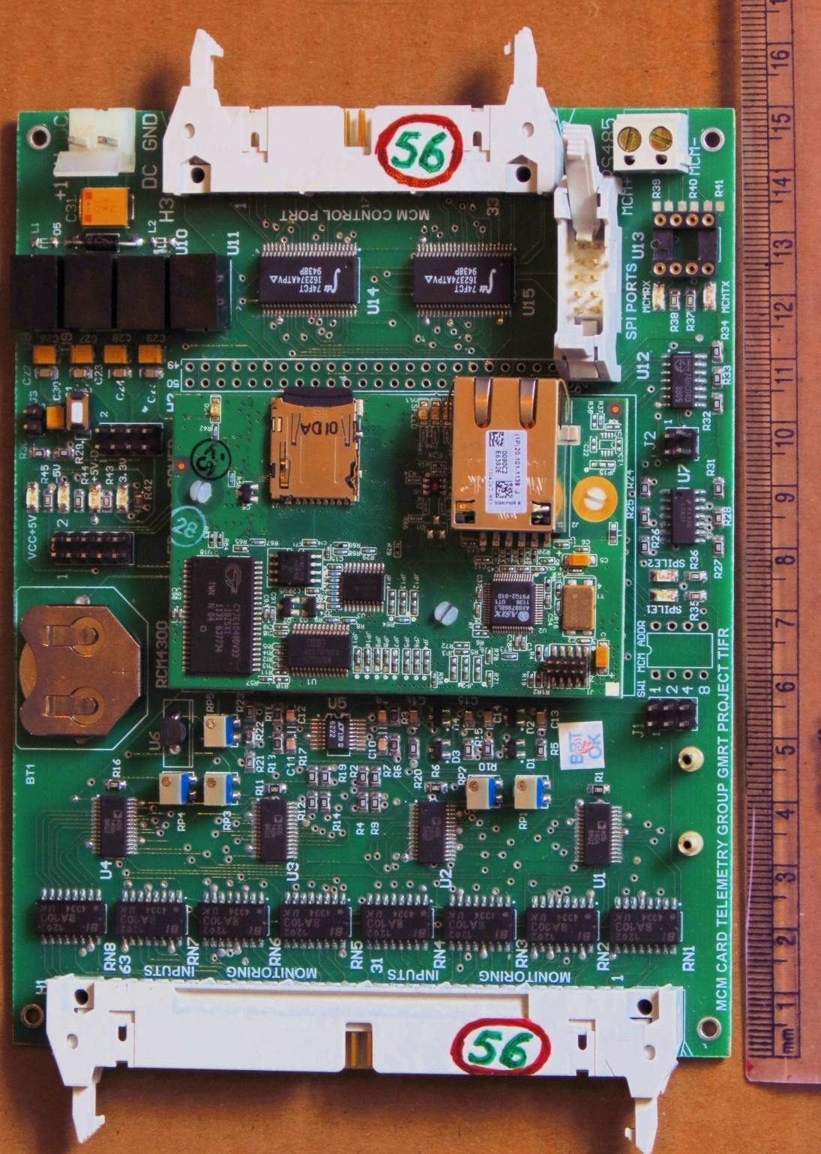
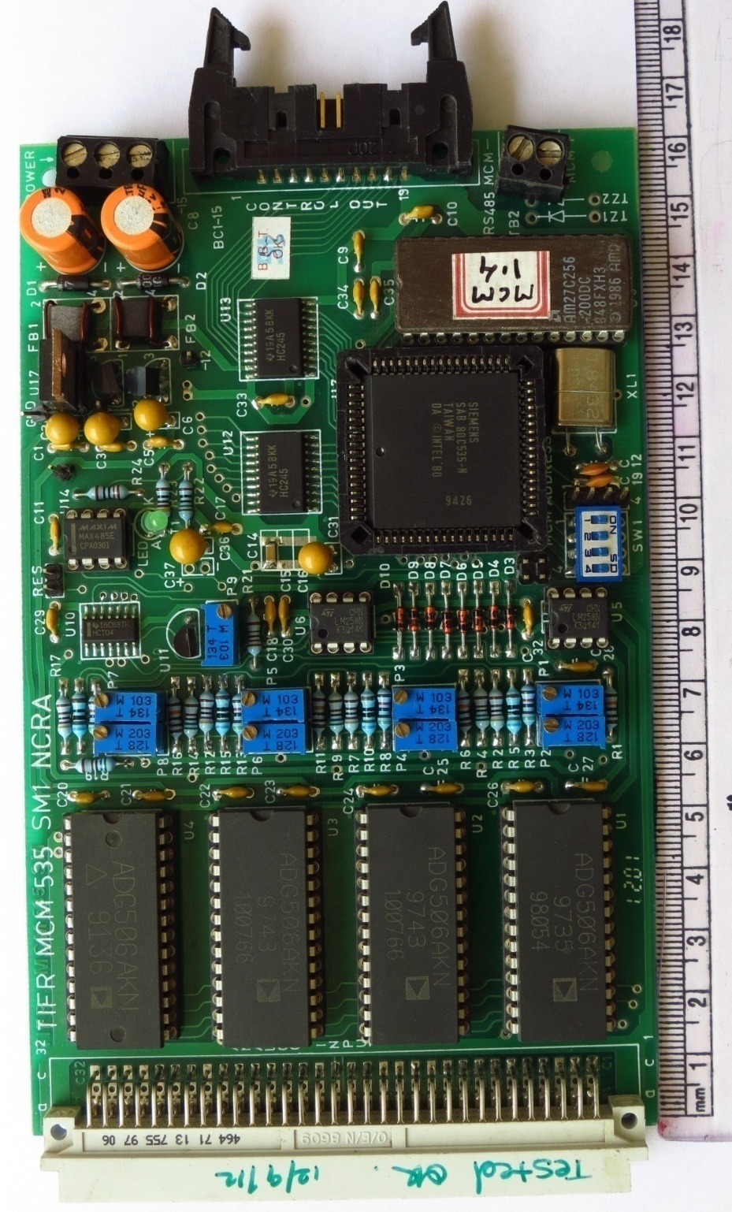
Monitor & Control Module (MCM)
New MCM
Old MCM
Notes:
<number>
<number>

Slide 5
GMRT Operation Activities
Observational Support
GMRT Engineering Coordination
Control Room Operations
GMRT Telemetry and Sentinel System
Post Maintenance Quality Check (PMQC)
Notes:
<number>

Slide 6
Outline of the talk
Introduction to GMRT Monitor and Control (M&C) System
M&C System : Hardware Up-gradation
M&C System : Software Up-gradation
GMRT Online Version 2.0
Next Generation M&C System : Industrial Collaboration
GMRT Sentinel System
GMRT Control Centre (GCC) and Control Room activities
Notes:
<number>
<number>
<number>

Slide 7
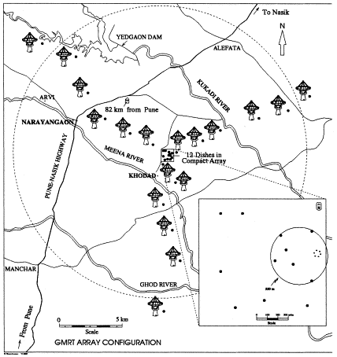
GMRT Monitor & Control System
GMRT M&C Features :
Central Supervisory system
provide User Interface
Sub-arrays : for Concurrent science/maintenance activity
Execute scheduled observing session in batch mode.
Safety measures
Sufficient interlocks are implemented in the servo system
Alarms/Alert
Archive and retrieve the logged information.
Existing M&C system is successfully operational since last ~ 15 yrs (Prof. A.P. Rao/R.Balasubramanain)
Notes:
<number>
<number>
<number>

Slide 8
Motivation and Objectives
GMRT Up-gradation :
Wide-Band Feeds (150 to 1500 MHz), Broad-band Fiber Link, Servo
Systems, GMRT Analog Base-Band (GAB) and GMRT Wide-Band
Back-end (Correlator) Systems.
All Sub-system provides 100 Mbps Ethernet Interface
OBJECTIVES :
(i) Develop end to end Radio Telescope Software.
(ii) Support for Remote Observing
(iii) Develop a generic Specification driven Frame-work for M&C System
Notes:
<number>

Slide 9
M&C System Hardware Up-gradation
Salient M&C System Hardware Features :
High end Server Class machines in CEB
Dedicated Ethernet/Optical Fibre Link (1 Gbps) to all thirty antennas
spread over Radial distance of ~ 15 km
Modern Monitor & Control Modules based on Rabbit RCM 4300 processor and
PC 104 embedded computer at each antenna.
100 Mbps Base Ethernet Port
Total ~180 Sub-system to be control and supervise.
Notes:
<number>

Slide 10
New MCM Vs Old MCM
Notes:
<number>
<number>

Slide 11
Performance Improvement
New MCM is 30 times faster than the existing one.
Higher program and data memory and 1GB storage
Higher ADC resolution
Double control bits
Ethernet, RS485 and SPI connectivity
High level programming language and method
20dB less EMI
Additional features like : Real Time Clock, Battery Backup
ASCII structure based Command structure
Failure rate will be minimum
Notes:
<number>
<number>

Slide 12
M&C System Software Up-gradation
M&C Software Development :
Two parallel development activities are in progress
In House M&C System Development : ONLINE_V2
Aim to support Up-gradation testing activities and smooth change
over from existing M&C (ONLINE) System to New M&C System
(ONLINE_V2)
Modern M&C System Collaboration with Industry Partner (TCS, Pune)
Developing Next Generation M&C System for the Radio Telescope,
test specification driven frame-work approach for SKA1 like
telescope.
Notes:
<number>

Slide 13
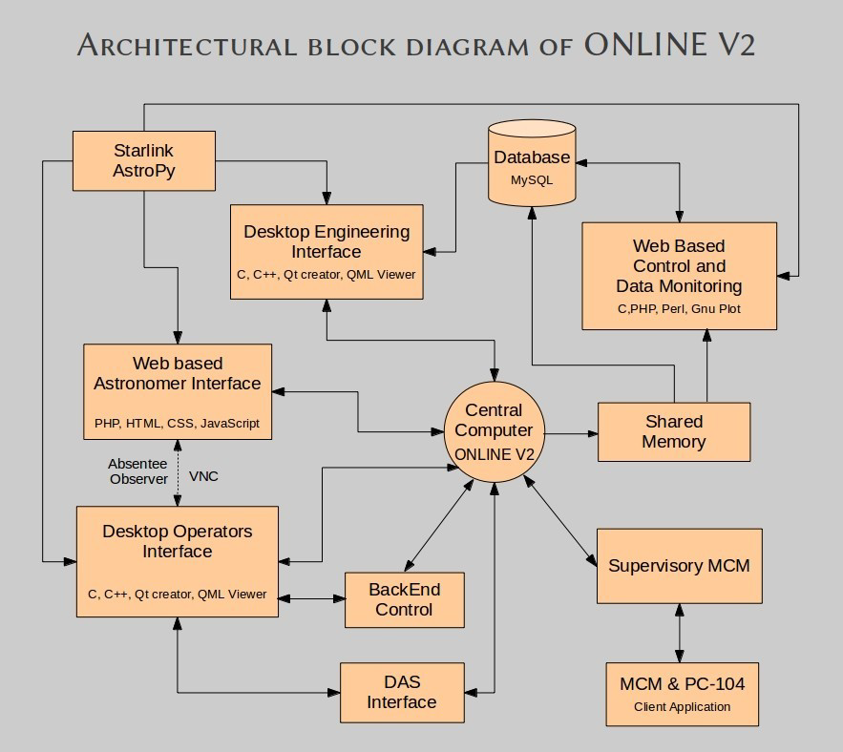
NOVAS
LIBRARY

Slide 14
Features of Online V2
The Online_v2 will directly communicate with Antenna based sub-systems using TCP/IP based socket communication, eliminating the need of ABCCOM ( Antenna base computer ).
Online_v2 communicates with Antenna sub-system using structure based protocol with most of the intelligence shifted to the lower level MCM program.
Online_v2 has been successfully tested with two antenna four sub-systems each in Telemetry lab
Online_V2 is successfully monitoring Antenna C03 shell temperature for last three months.
Online_v2 Provides QML Web-based GUI for Control & Monitoring.
Notes:
<number>
<number>

Slide 15
Milestones of Online_V2
Online_v2 has been successfully tested with 8 Rabbit MCM antenna setup in Lab along with 1 L3 Network switch.
Online_v2 has been successfully tested in C06 antenna during April-2014
maintenance period for two sub-system Sentinel & optical fiber.
Online_v2 has been successfully tested in C01,C04 & C06 antenna during October-2014 maintenance period for two sub-system Sentinel & optical fiber.
Online_V2 is successfully monitoring Antenna C03 shell temperature for last three months.
GWB correlator has been successfully interfaced with Online_v2. It has been thoroughly tested during April-2014 maintenance period.
Servo system with PC104 card has been successfully interfaced & tested with Online_v2 with actual hardware setup in SSL Lab.
Online_v2 has been successfully interfaced with QML Web-based GUI for Control & Monitoring, Readline library based terminal as well as Python environment.

Slide 16
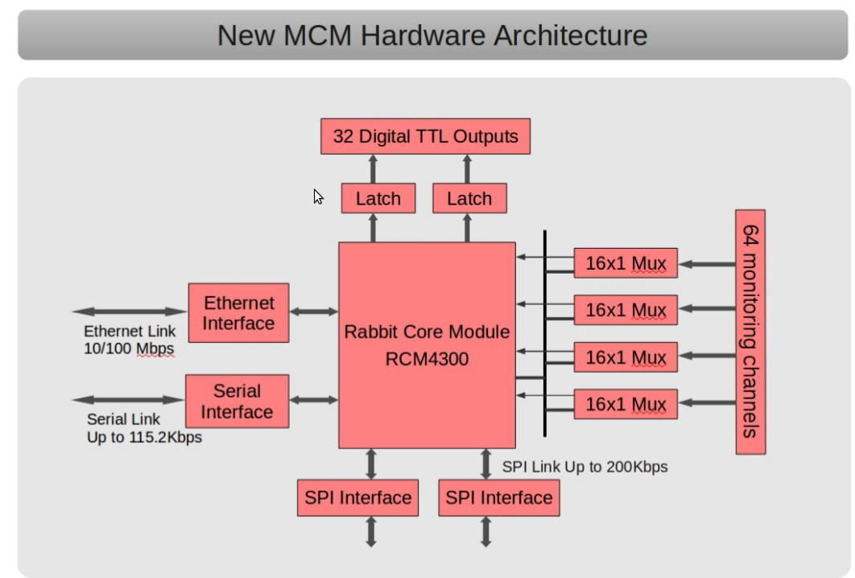

Slide 17
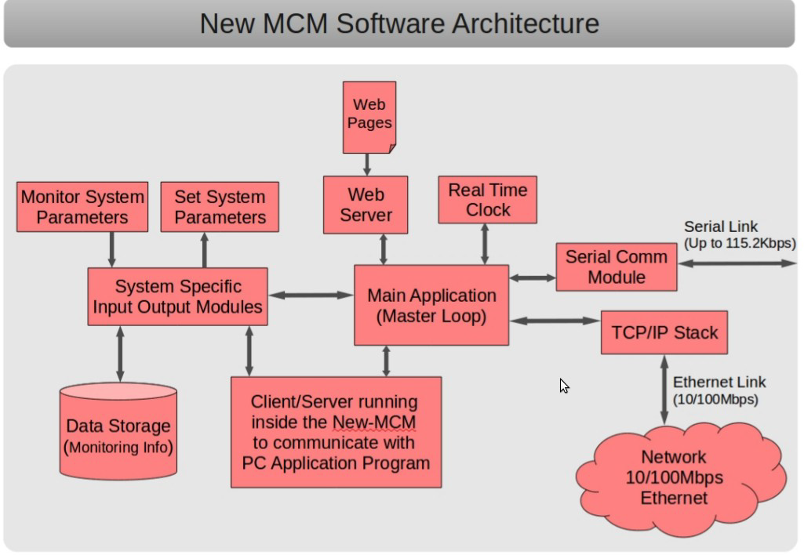

Slide 18
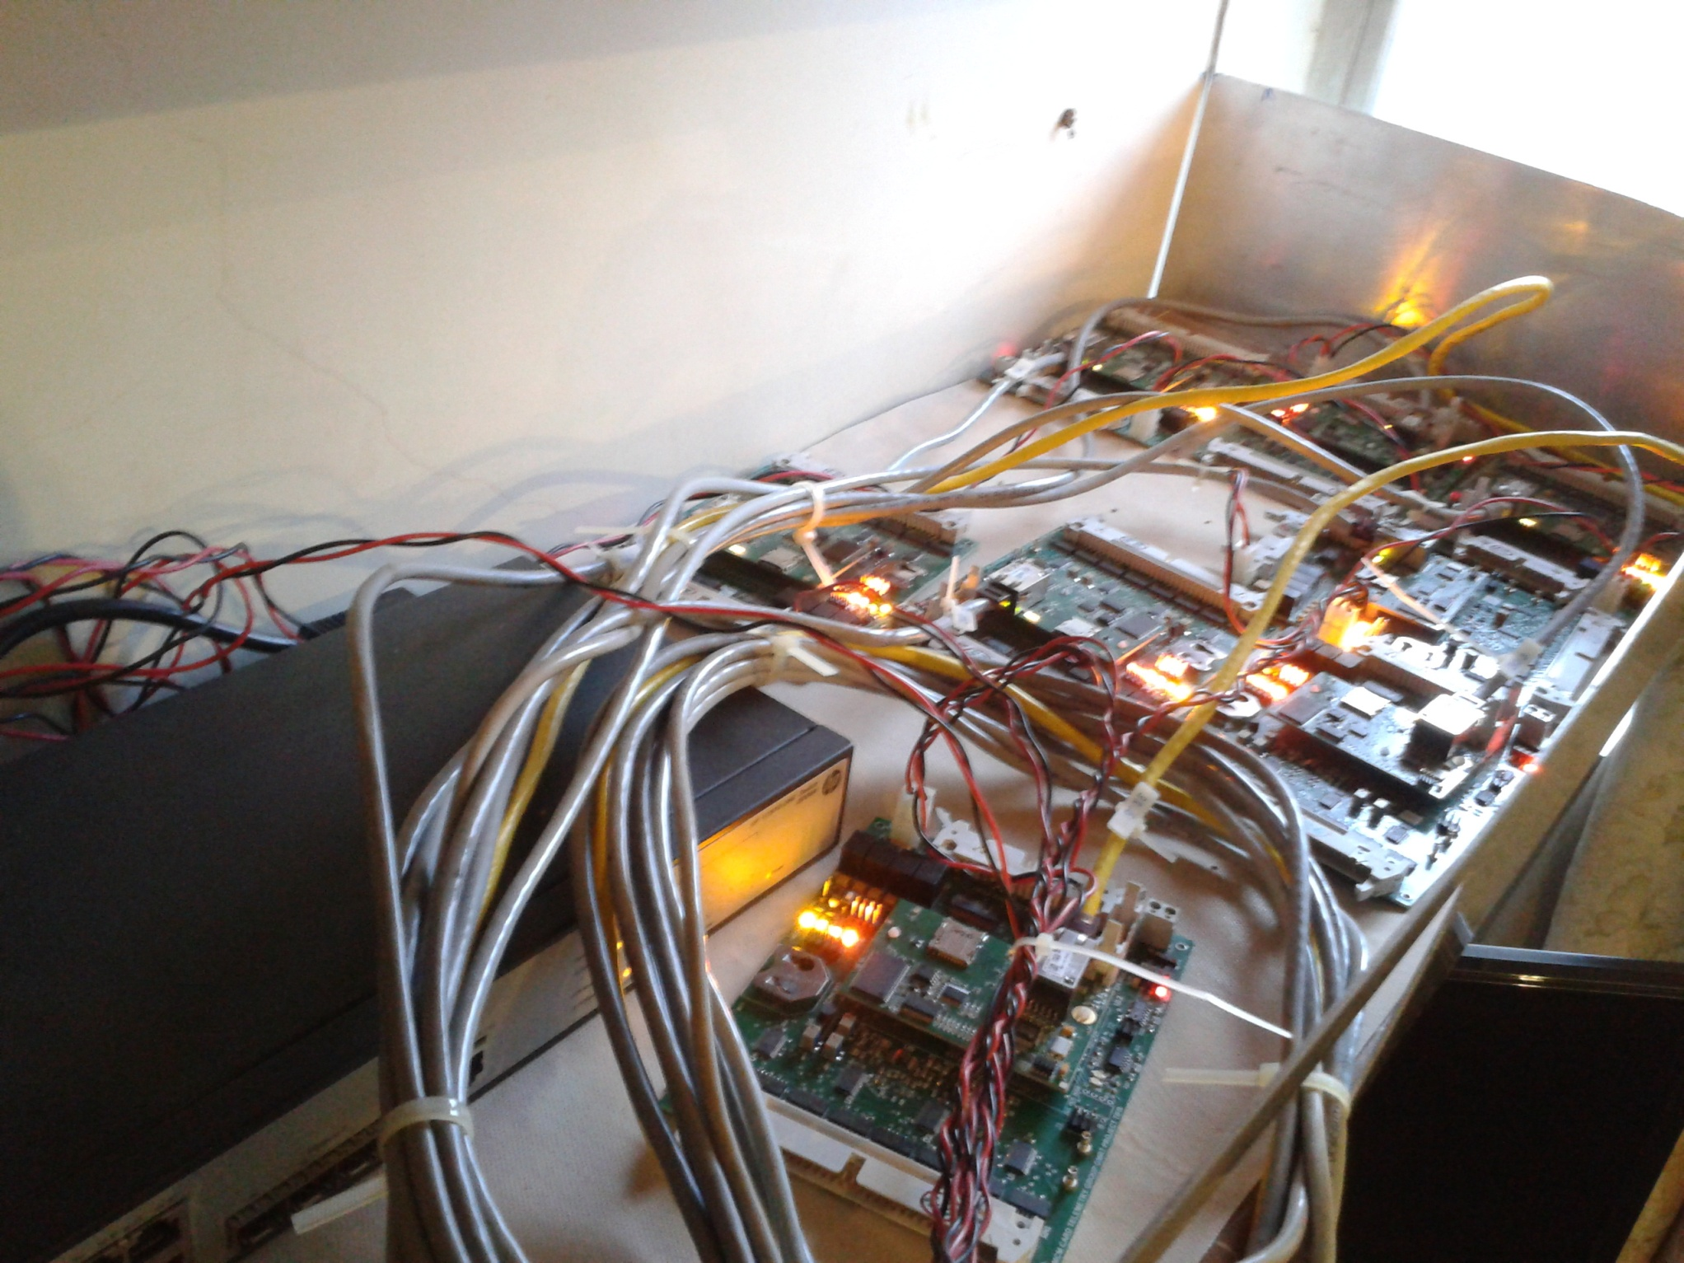
Lab Test Set Up
Notes:
<number>
<number>

Slide 19
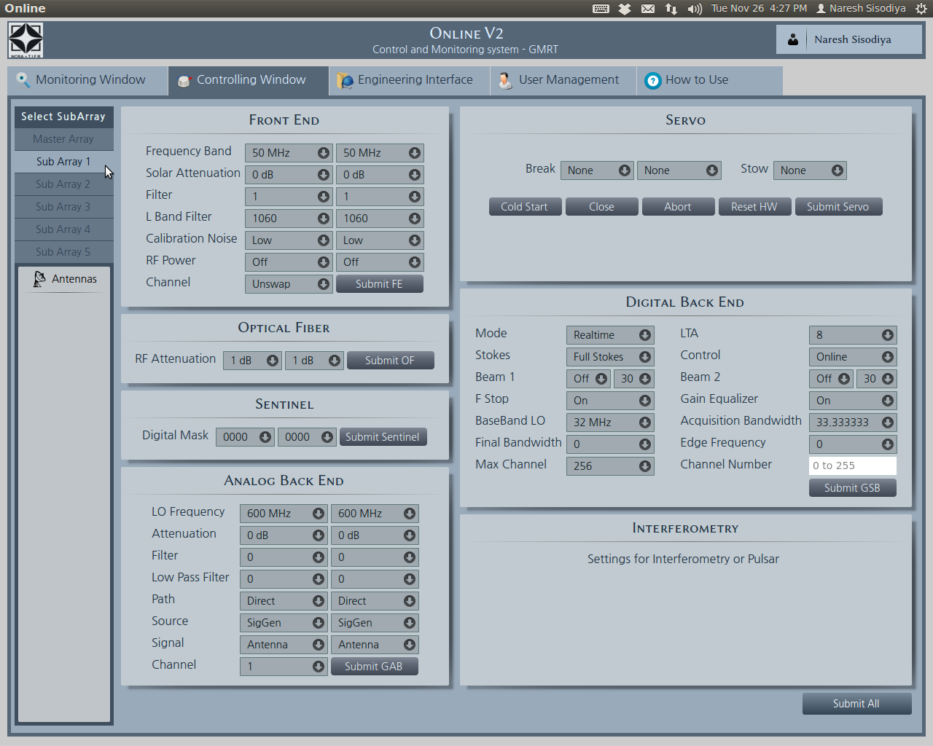
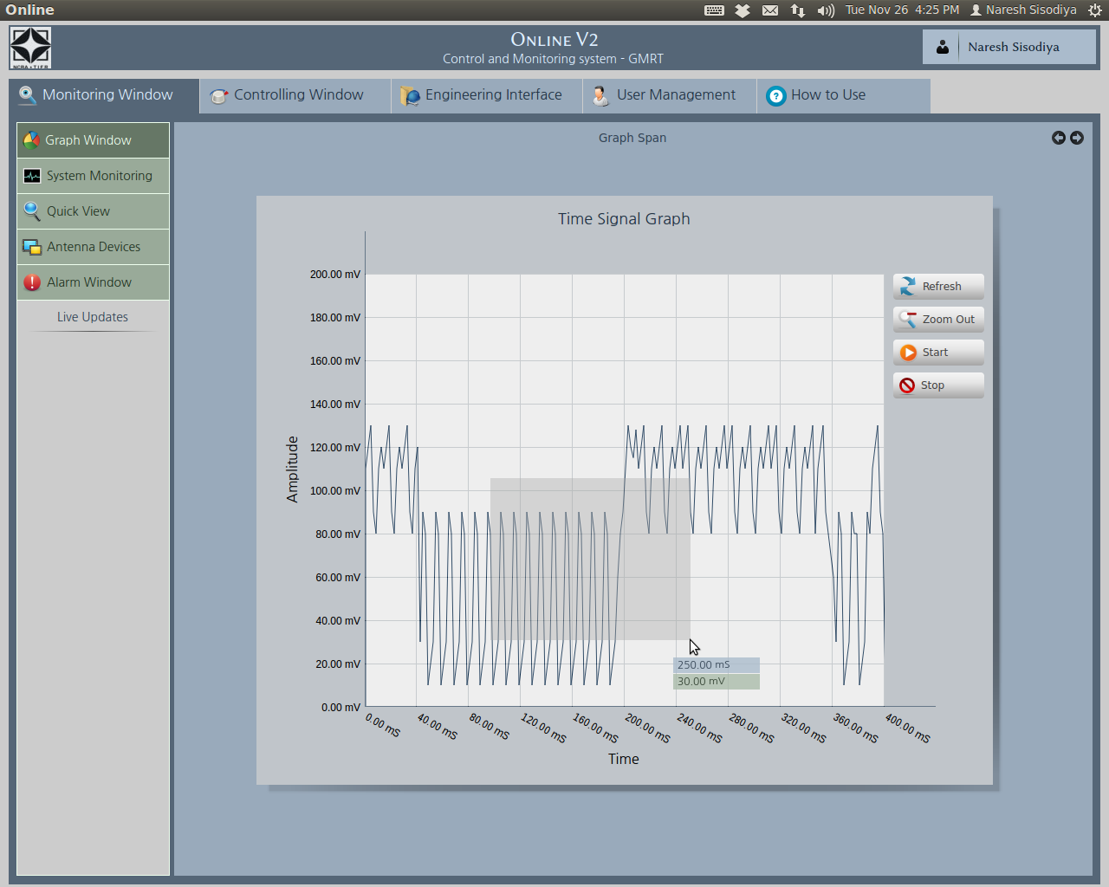
QML Based M&C GUI (Online_V2)
Notes:
<number>
<number>

Slide 20
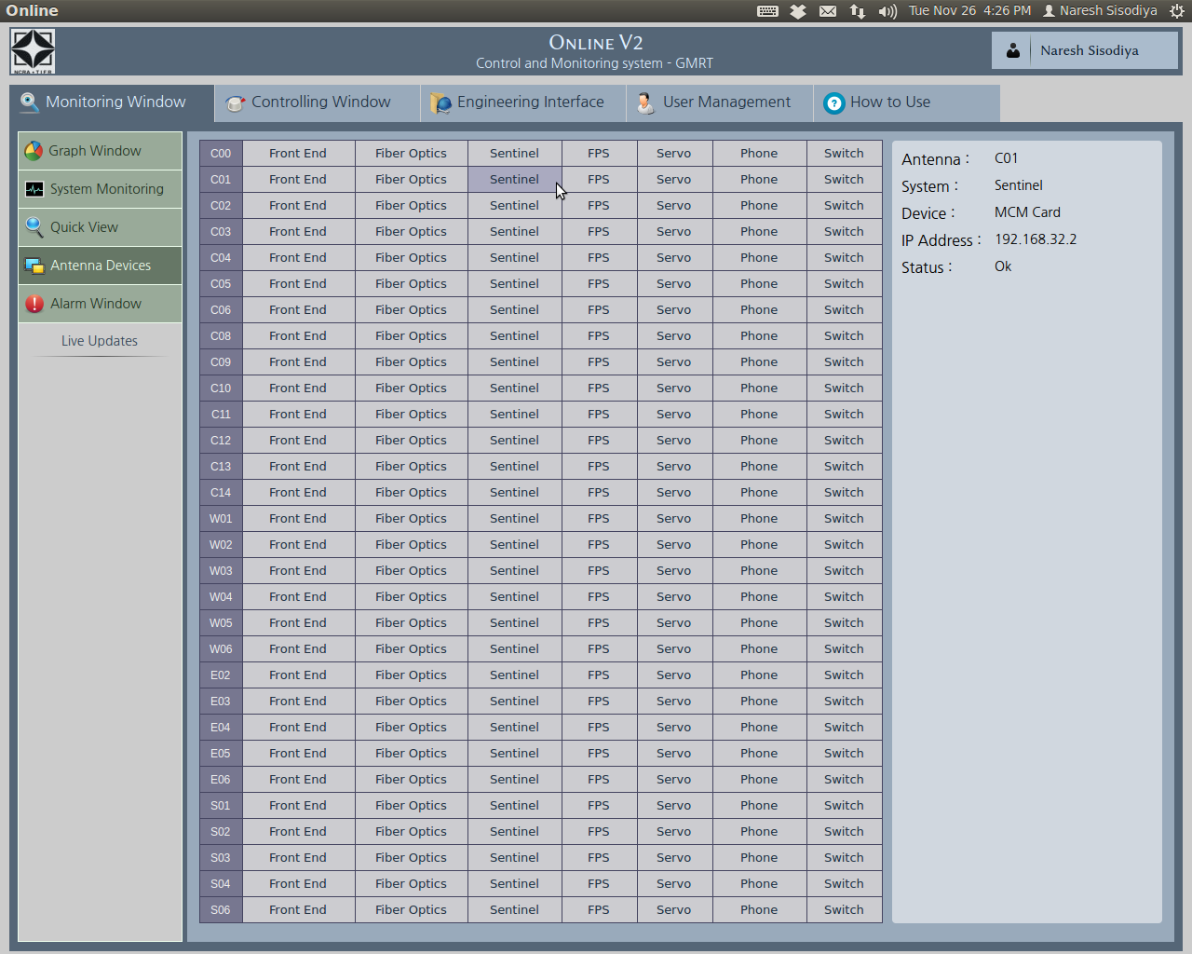
QML Based M&C GUI (Online_V2)
Notes:
<number>

Slide 21
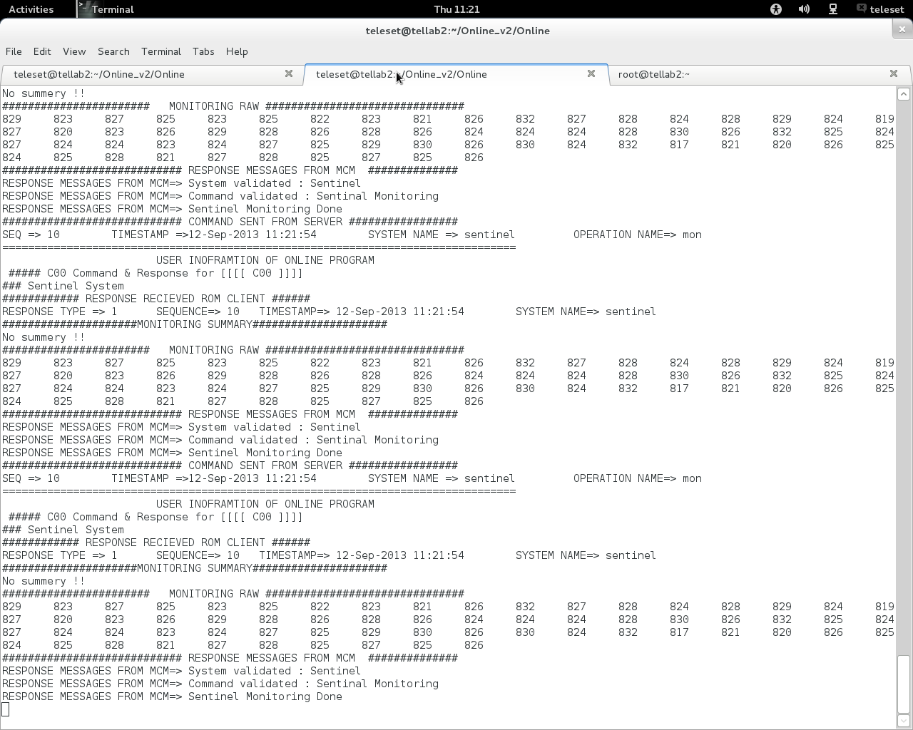
Shared Memory Display of Online V2 (Lab Set Up)
Notes:
<number>
<number>

Slide 22
GMRT Upgrade : M&C Challenges
Aims to develope a Generic Specification Driven M&C frame-work to support evolution or upgrade phase over next decade (Instead of developing device specific bespoke solution)
End-to-end Radio Telescope M&C software which processes and execute scheduled Observing proposal in auto mode and supports science data analysis by providing meta-data (Observation log, bad-data flagging, M&C system and metrology data Logs etc)
Modern M&C System, industry collaboration (TCS, Pune) to leveraging the technlogy trends to upgrade the M&C Hardware and Software.
Showcasing the capabilitites of NCRA for handling the Telescope Manager (TM) Package for SKA1
Notes:
<number>
<number>
<number>

Slide 23
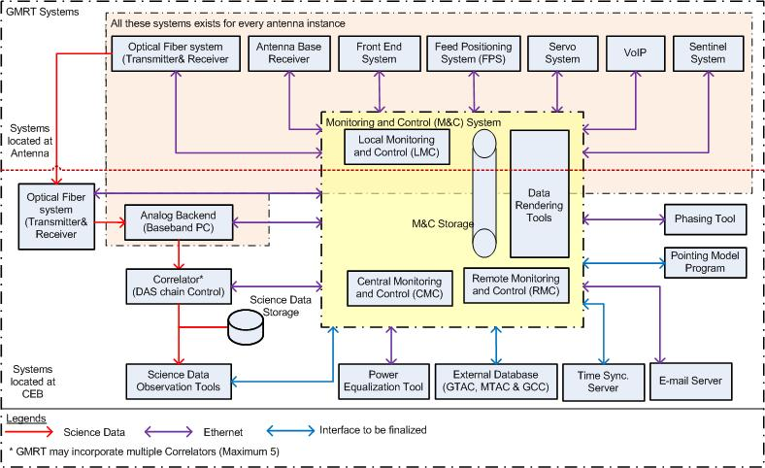
GMRT M&C System Upgradation Block Diagram
Notes:
<number>
<number>
<number>

Slide 24
Present Status of Next Generation M&C System
MILESTONE ACHIEVED :
User Requirement Specification (URS)
Software Requirement Specification (SRS)
Proof of Concepts (POC)
Graphics User Interface (GUI)
Software Architecture Development (SAD)
Notes:
<number>
<number>
<number>

Slide 25
URS and SRS Phase for the New GMRT M&C System
User Requirement Specifcation (URS) Dec 2012 to Feb 2013
Aim : To clearly communicate the end-user/customer needs to the vendor/technical community so that development gaps and errors can be avoided at the beginning of design phase of the system itself.
- All stake holders Inputs (Astronomers, Engineers, Coordination/Management personnel and Telescope Operator) collected through Questionnaire – To identify expectation and work-flow associated with each User Role.
- A system description of upgraded GMRT and Observing modes capability doc.
- Total 35 Use-cases/Business Process documented along with UML diagram, process rule, exception etc.
- High level Functional and Non-functional Requirements Documented.
Software Requirement Specification (SRS) Mar to Aug 2013
Aim : (i) Identify Software and Hardware Requirements of GMRT's M&C System and orgnize systematically in HRS and SRS documents such that it shall enable designer to design a system to satisfy those requirements, and testers to test that system satisfying those requirements.
(ii) Reduce the development effort by careful review of the requirements in the SRS to reveal inconsistencies, omissions and misunderstandings early in the development cycle.
- Total 730 requirements documented with ranking for stability, importance, verifiability and traceability.
Notes:
<number>
<number>

Slide 26
Continued..
M&C System Prototype Study (Technology Evaluation) Oct 2013 to May 2014
Aim :
(i) Explore the possible technology selection (Open Source) in a view of finalizing the M&C system architecture for the final production version.
(ii) Identify and Mitigate possible risks that may occur while implementing the next generation GMRT M&C System production version
- Selected technologies like EPICS (Experimental Physics and Industrial Control System) , CSS (Control System Studio) and BEAST (Best Ever Alarm System Toolkit) are explored.
- Technology Evaluation was done using two approaches, bulting a M&C system prototype at PoC level to elicite the basic M&C System Software requirements and evaluate the technology based on quantitative assessment using the criteria like usability, maintainability, reliability etc.
Software Architecture Description Document May 2014 to December 2014
Aim :
(i) Explore the possible technology selection (Open Source) in a view of finalizing the M&C system architecture for the final production version.
(ii) Identify and Mitigate possible risks that may occur while implementing the next generation GMRT M&C System production version
Notes:
<number>
<number>

Slide 27
Continued..
Graphical User Interface Design May 2014 to November 2014
Aim : In early stages, (i) Helps to identify and validate the user's requrirements and predict the usability of the product. (ii) Instead of designing the UI by individual designer at each phase of the project, a overall UX design phase for the GMRT Next generation M&C project taken up. This aims to avoid the re-design of the UI and conflicts that may occur in sub-sequent developmental phases of the project.
- A wire-frame diagram, uniform screens designed as per the requirements and documented after close collaboration with each stake-holder of the GMRT M&C System.
Notes:
<number>
<number>

Slide 28
Delivery Phase – Development Plans
An incremental approach – Allow to provide feed back on each delivered phase. Reusability of the components. Resources like time and man power can be held constant while the system size grow over the time.
GMRT M&C System production version as an SKA1 TM exploratory prototype :
- As GMRT M&C system production version has OBSMGT, TELMGT.LMC , TELMGT kind of concepts, hence it can be a test-bench for concept and sub-package testing.
- Specification Driven Approach.
- Considering GMRT M&C as a LMC, TM interface capability and compatibility can be checked.
- The GMRT M&C System Production version will help in understanding the overall TM package feasibility.
GMRT M&C System production version :
I. A Core M&C System with Three Antennas and Single Sub-array.
II. Business logic and Axuiliary Application with the core M&C Functionality.
III. Web-Application development.
Estimated time efforts for each phase is around 6 months, target date of project completion is around March 2016.
Notes:
<number>
<number>

Slide 29
GMRT Sentinel System :
I was assigned for a new responsibility to take care of safety of the telescope which is under continuous operation(7X24). Therefore, I took up the development of Sentinel System which monitors the critical parameters for safe operation of 30 nos. of 45 metre diameter dish antenna in and around the GMRT campus, Khodad
GMRT Sentinel System consists of Temperature Control and Monitor, Smoke and Fire detections, Intruder alarm and Air quality monitoring of the antenna shells.
I have successfully designed, developed, installed and commissioned world class electronics safety and security system in all the GMRT Antenna Shells. This system is providing complete safety and protection to all sensitive and costly electrical/servo/electronics sub-system from high temperature, smoke, fire, intruders etc. High power servo drives, three phase transformer, chokes other electrical appliances inside shielded cage are producing enormous heat inside the antenna shell which may cause serious destruction and damages to the Electronics. This high temperature is harmful for equipments and instruments inside the shielded cage in the antennas shell.

Slide 30
Salient features of this sentinel systems:
Low cost design approach – components are available readily in the open
market in Pune/Mumbai
It is very compact due to simplified design approach.
It is completely RFI free system.
Self intelligent and fully automatic
Fully independent and unaffected due to failure of external communications (OFC/Telemetry).
Automatic Power shutdown in case of over-temperature, smoke and fire.
Automatic Power Switch-ON in the normal conditions.
Communicating with the existing online and online-V2 of the Telemetry system of the GMRT.
Local as well as remote monitoring facility
Air quality monitoring system
Very reliable and working satisfactorily more than a decade.

Slide 31
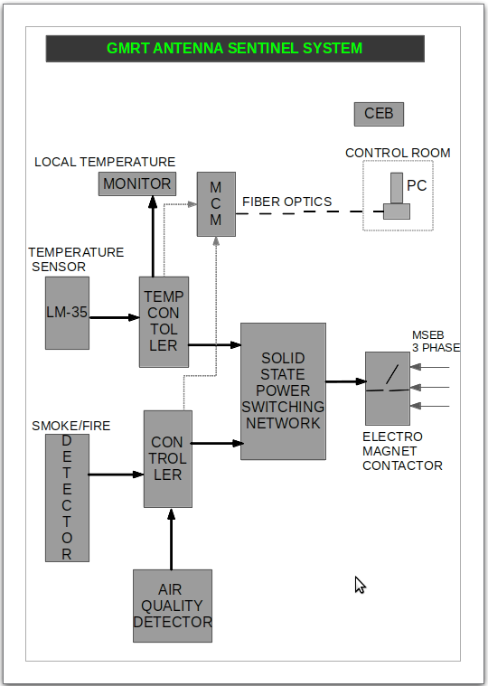

Slide 32
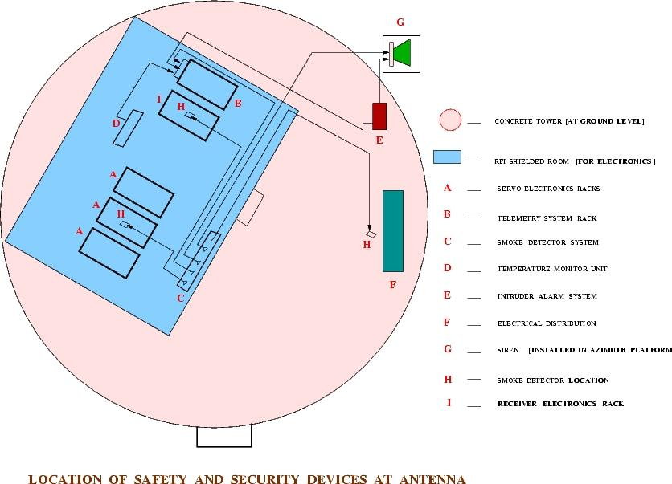
LOCATION OF SAFETY AND SECURITY DEVICES AT ANTENNA

Slide 33
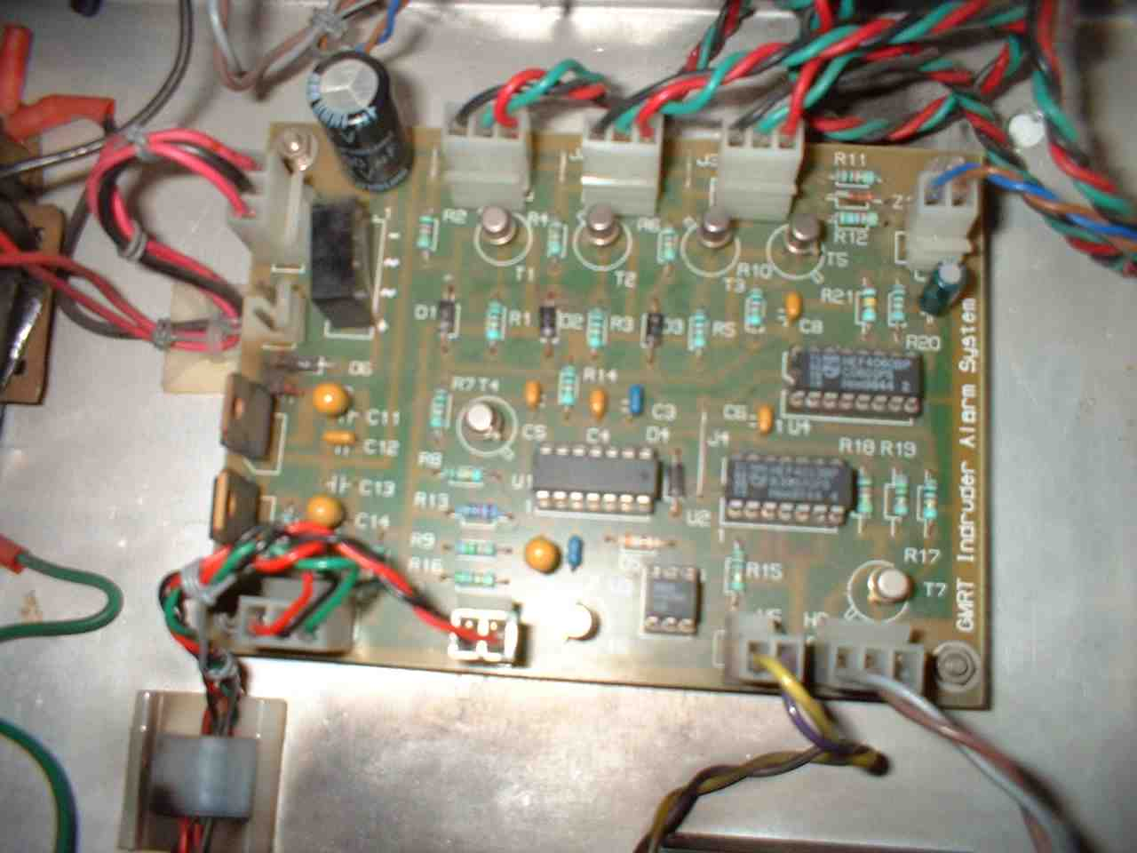
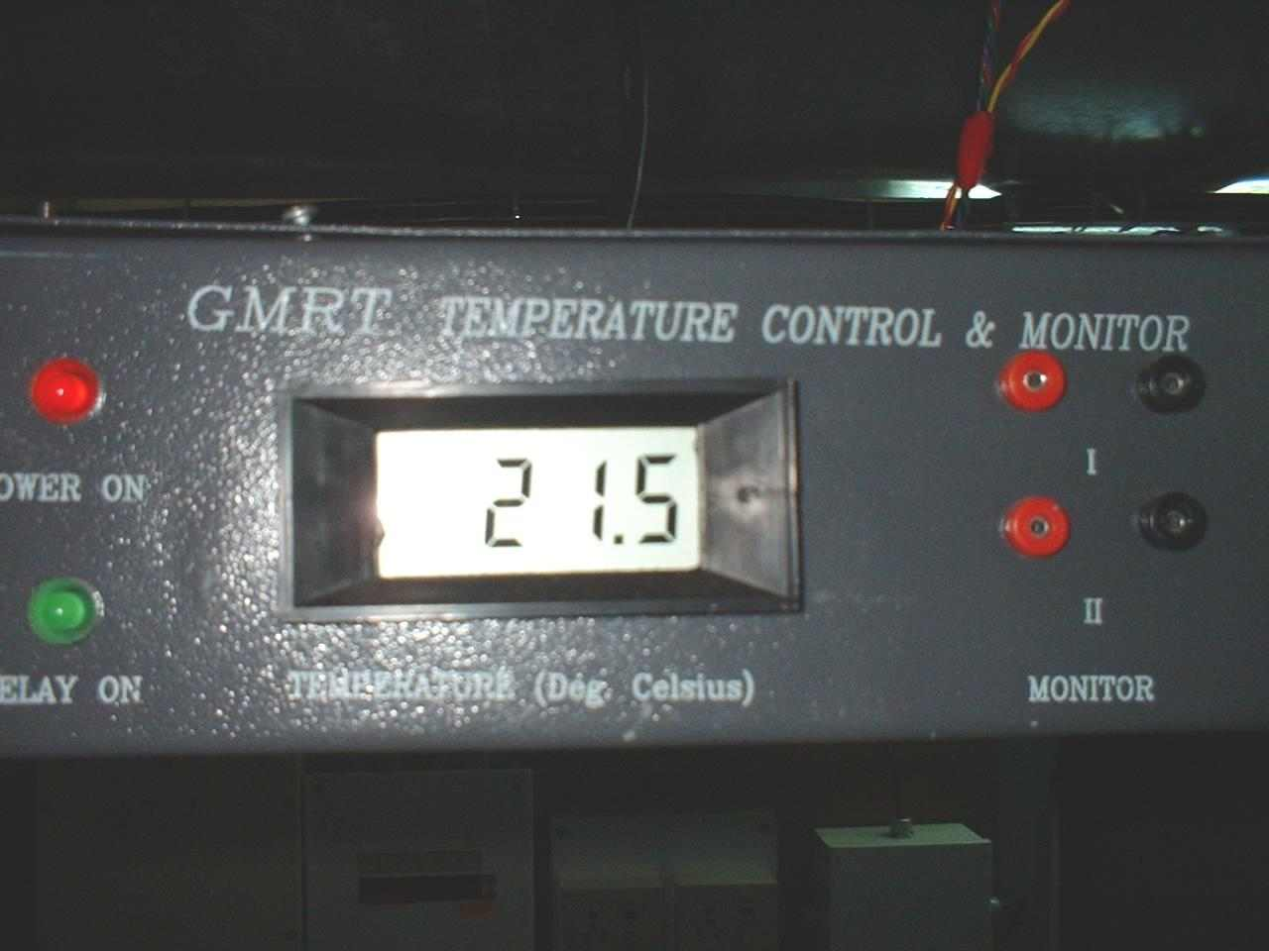
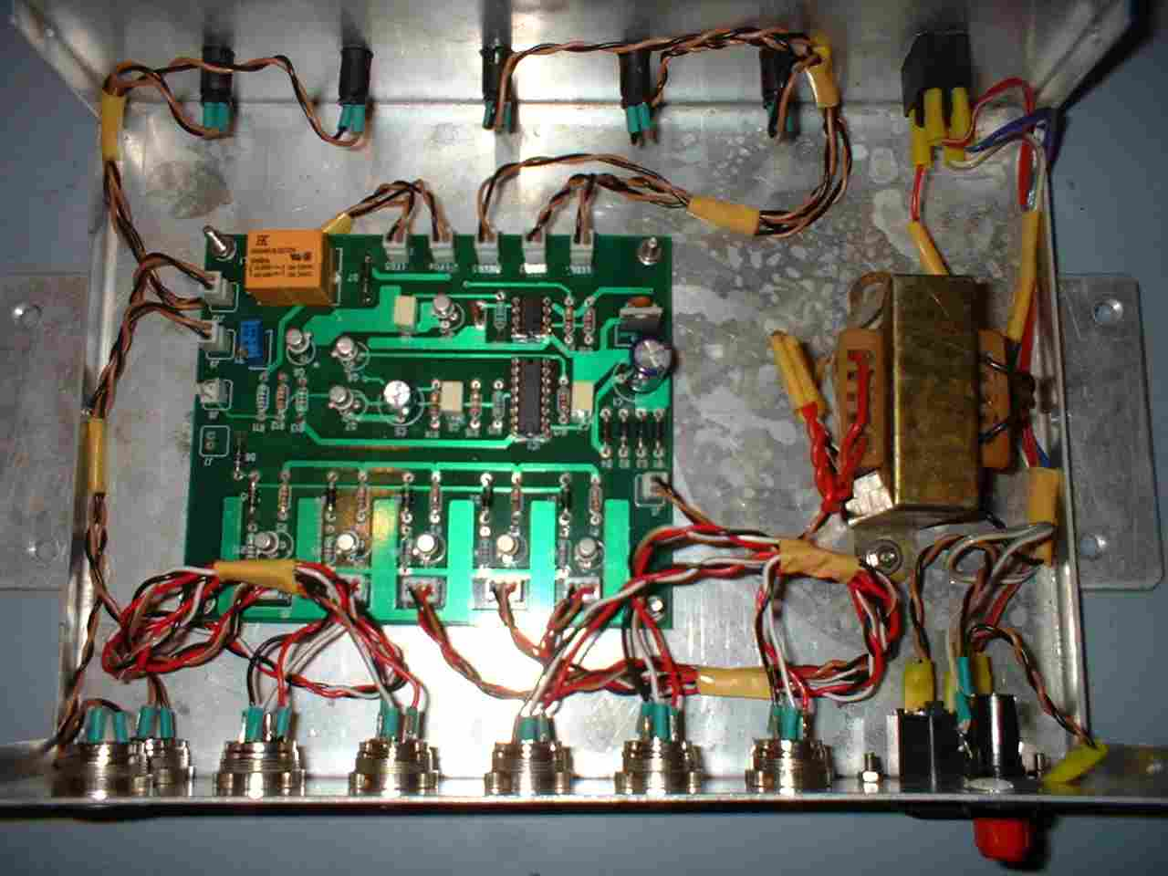
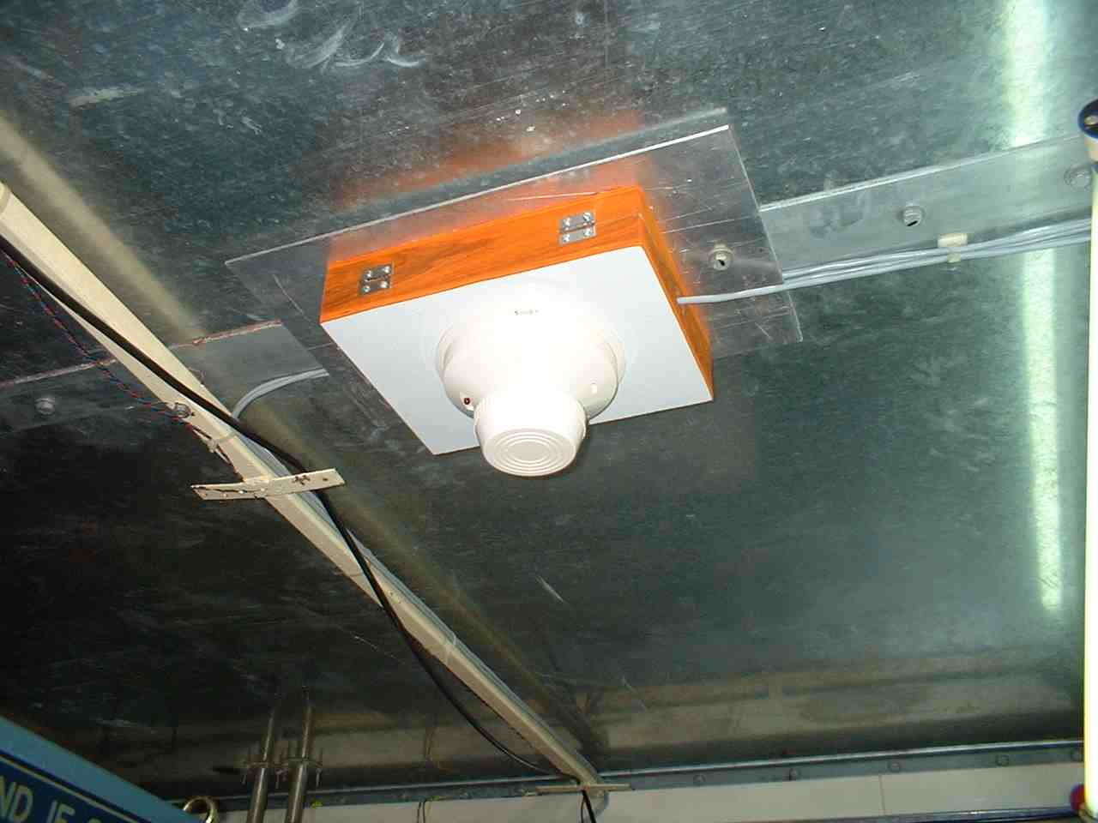
ELECTRONIC SAFETY DEVICES INSIDE THE ANTENNAS

Slide 34
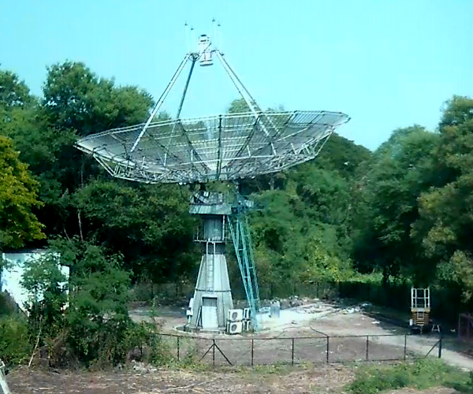
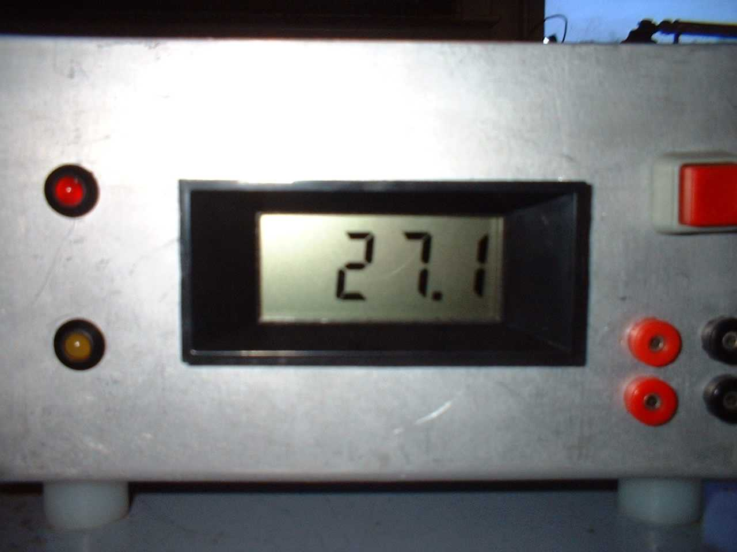
Installation and commissioning of Electronics Safety
System in the 15 metre antenna at NCRA, Pune.
This challenging new project is headed by Prof J. N. Chengalur. This important instrument is dedicated for frontline research on Radio Astronomy as well as an educational tool for enthuses young scientists and engineers leading to study on Radio Astronomy and Astrophysics.
Like GMRT, here also there are electrical and Electronics sub systems i.e. servo, receiver, telemetry and fibre optics. All these sub systems do not have their own safety system. Hence it is a prime responsible for me to provide total safety to all these sub systems from the critical parameters like over temperature, smoke, fire etc. for smooth and successful running of the antenna. Therefore, I have successfully installed Electronics Safety System for the 15 metre antenna at NCRA, Pune

Slide 35
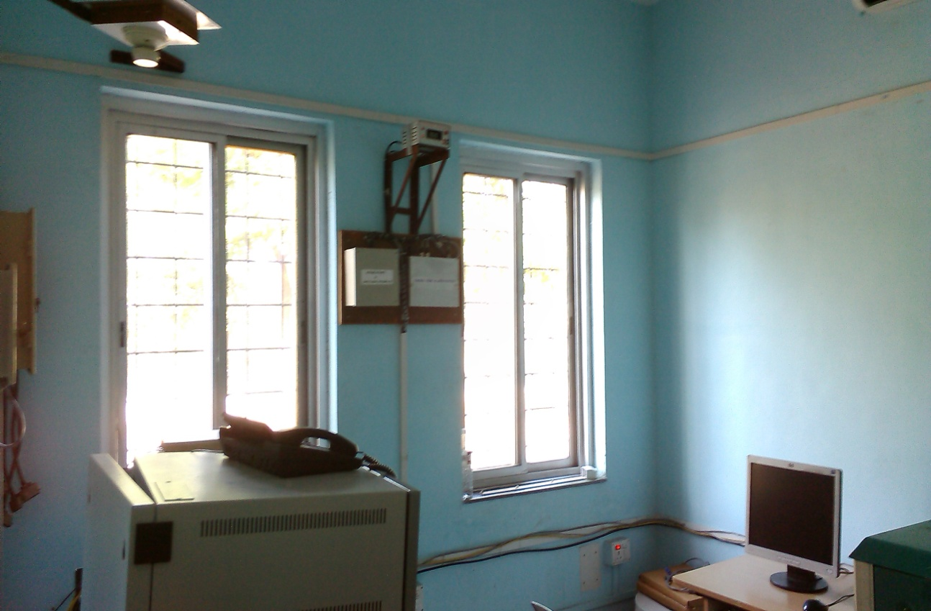
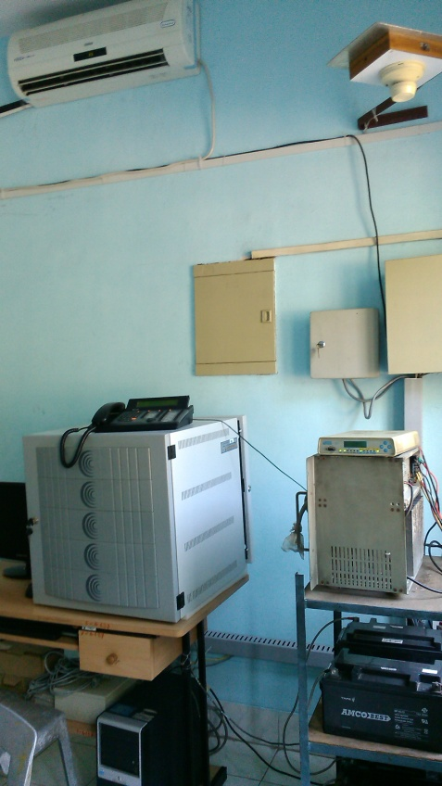
Installation and commissioning of Electronics Safety System
in the Utility Building at Narayangaon Housing Colony.
Utility Building at GMRT Housing Colony at Narayangaon is well equipped with high speed date/internet link and hub between NCRA and GMRT with optical fibre connectivity. Over temperature, smoke and fire is very critical inside the room. Therefore, I have successfully installed and commissioned Electronics Safety System in the Utility Building.

Slide 36
Three Phase Status Monitoring for the D-G Set/MSEB
of the remote GMRT antennas.
Power back-up is very essential during the GTAC Observations for the smooth running of the GMRT antenna. Therefore, D-G Set provides the back-up power for each antenna in case of MSEB failure.
In the antenna, there are also many instances when D-G Sets are keep running abnormally even in the presence of the MSEB power, thereby causing huge loss of fuels (diesels). This is because of control failure of D-G Set after the MSEB power is resumed. To overcome this problem, We have successfully designed, developed and installed an electronic system for continuous monitoring the status of three phases of MSEB and D-G Set for each antenna. Its design approach is very simple, low cost, reliable and RFI free system and it is working satisfactory in the antenna shells. For this purpose, we have also developed a software for running with the existing online system so that we can monitor the power status all the time.

Slide 37
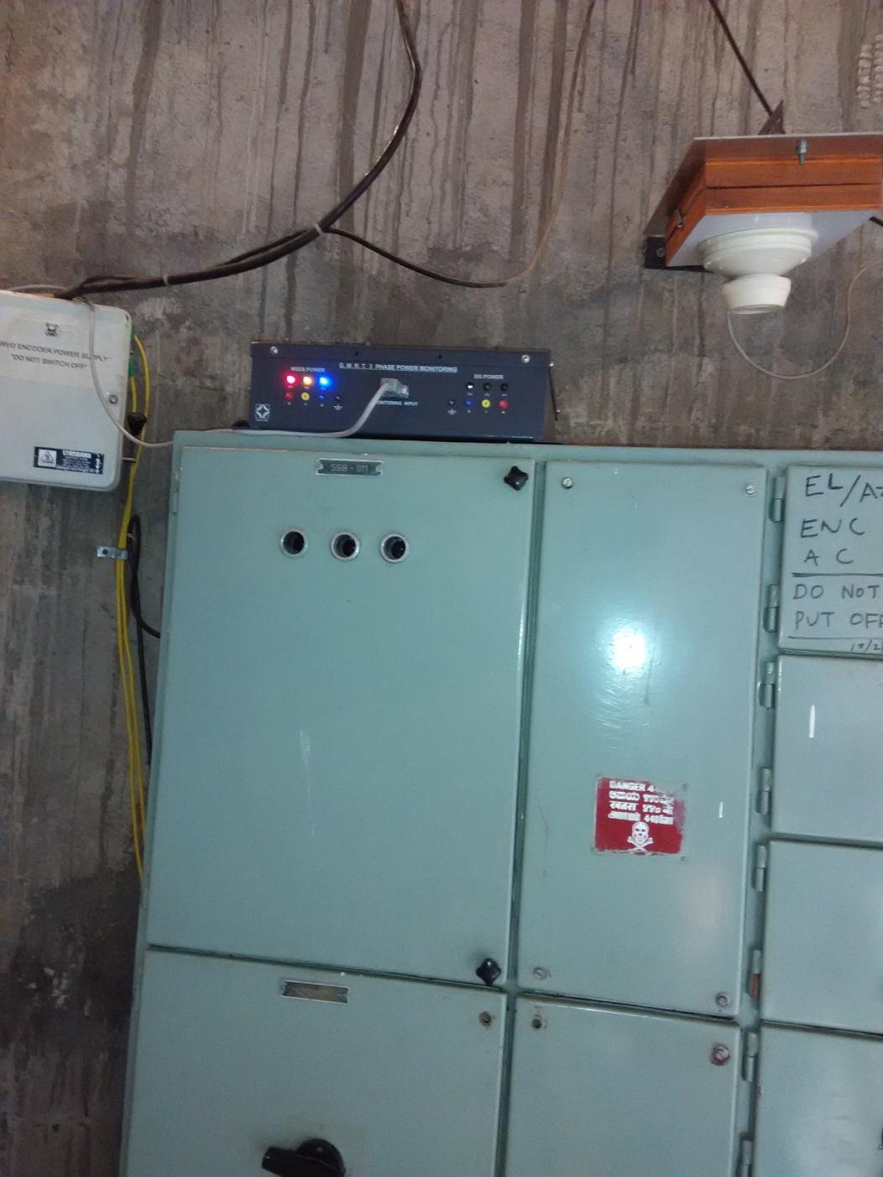
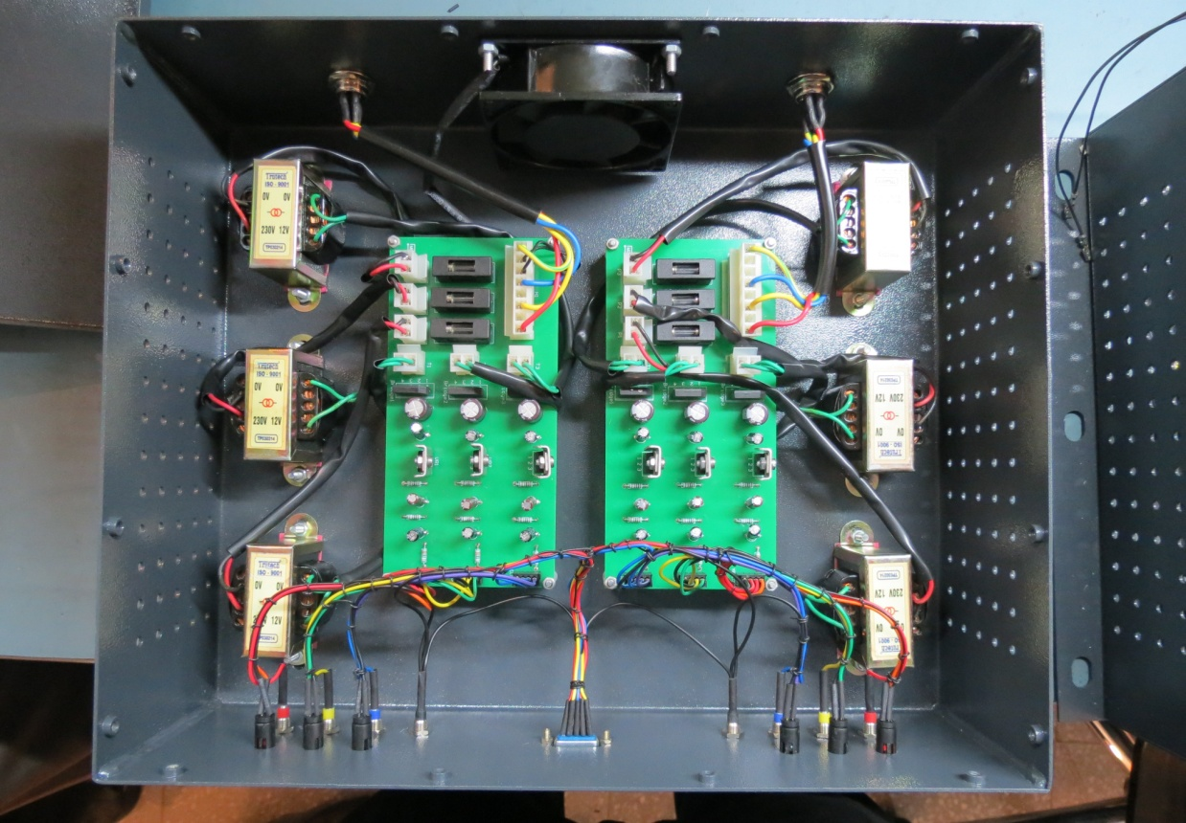
Three Phase Status Monitoring for the D-G Set/MSEB
of the remote GMRT antennas.

Slide 38
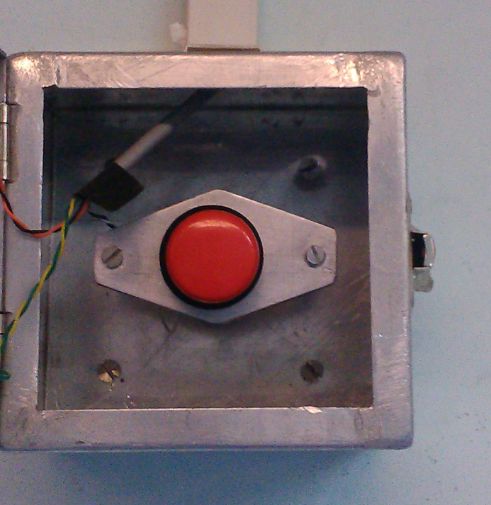
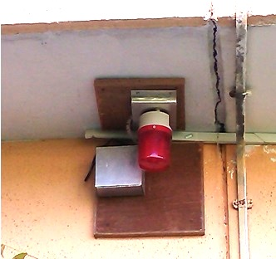
Installation of Panic Alarm System in the Control Room
at the CEB.
Control Room is heart of the GMRT Observatory. It is fully functioning throughout the years, day and night.
A Panic alarm system is provided in the control room for operators working in the night shift in the control room to provide instantaneous/emergency help when any uncomfortable situations arising in the night especially for women.
Therefore, we have provided this additional safety measure called “ Panic Alarm System” in the Control Room at GMRT. Its design approach is very simple, low cost, reliable and RFI free system and it is working satisfactory.

Slide 39
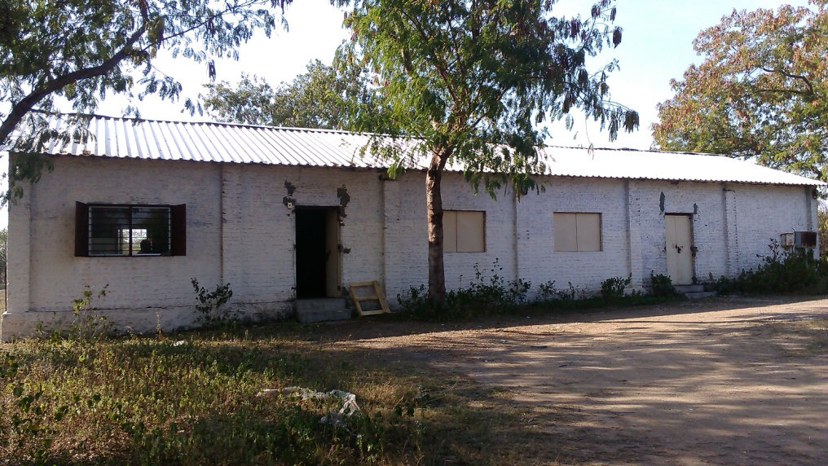
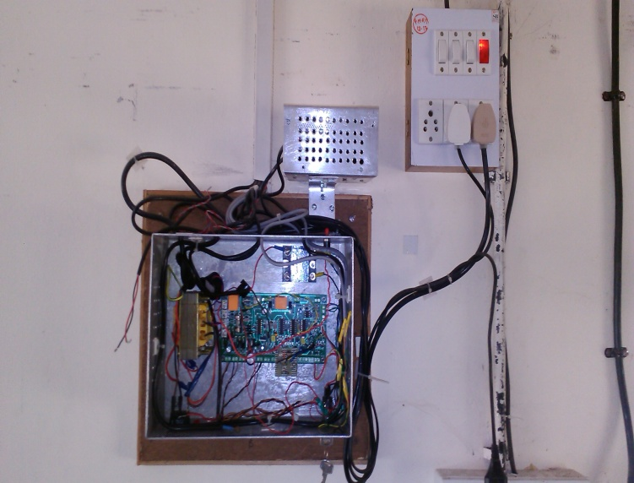
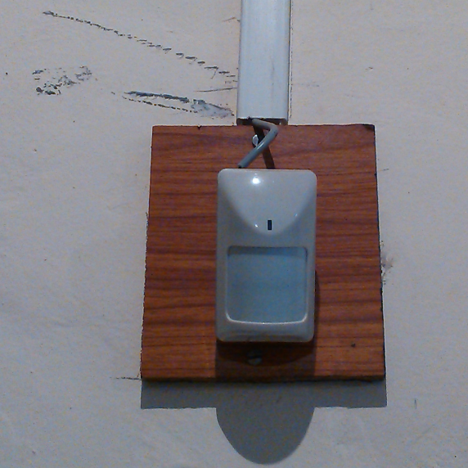
Installation and commissioning of Electronics Safety
System in the SSL shed.
Servo Group has initiated the Lab activities in the SSL shed especially for Brushless motor and drives. Servo system is storing very valuable and high value items for retrofitting 30 antenna brushed motor drives with brushless motors and controllers in the SSL shed. Since this shed is located away from the main building it is necessary to provide safety and security of the place from pilferage. So we have developed and installed temperature monitor, smoke , intruder, fire and camera.

Slide 40
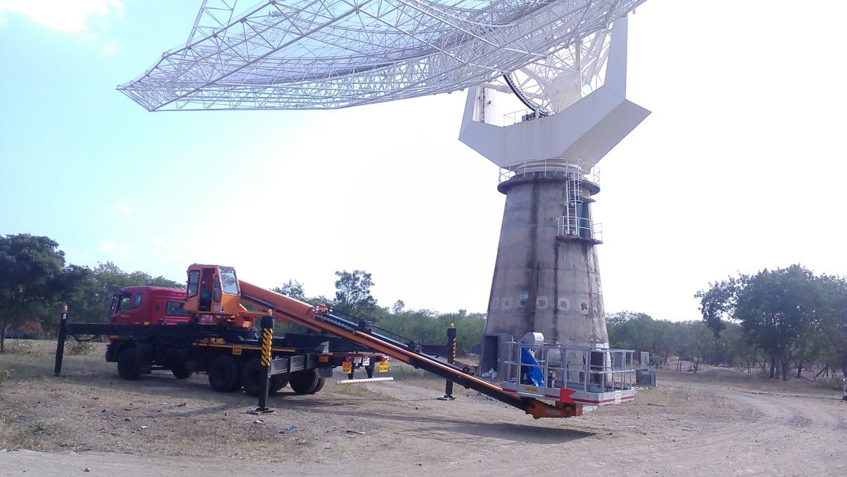
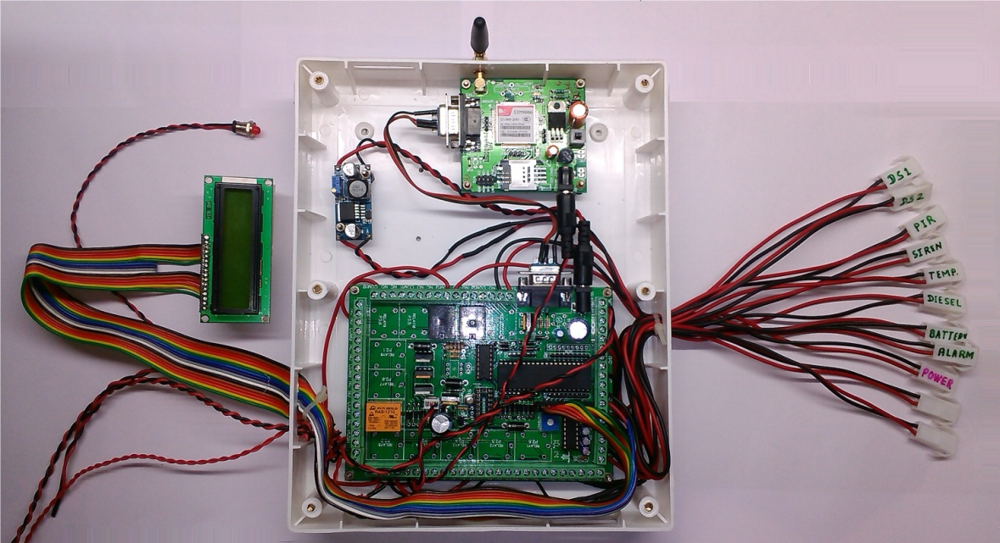
Installation and commissioning of Electronics Safety
System in the High Lift Platform (HLP)
In the GMRT Observatory, High Lift Platform (HLP) are very important tools for the GMRT antenna woks for smooth functioning of the telescope. HLP consists of a heavy vehicle and it has inbuilt fuel tank, high capacity batteries and other valuable items also. Hence we have provided electronics security and safety system in the HLP to avoid thefts and any damage to it. This system is working successfully and it will activate only if there is a measure breakdown of HLP in a very remote location.

Slide 41
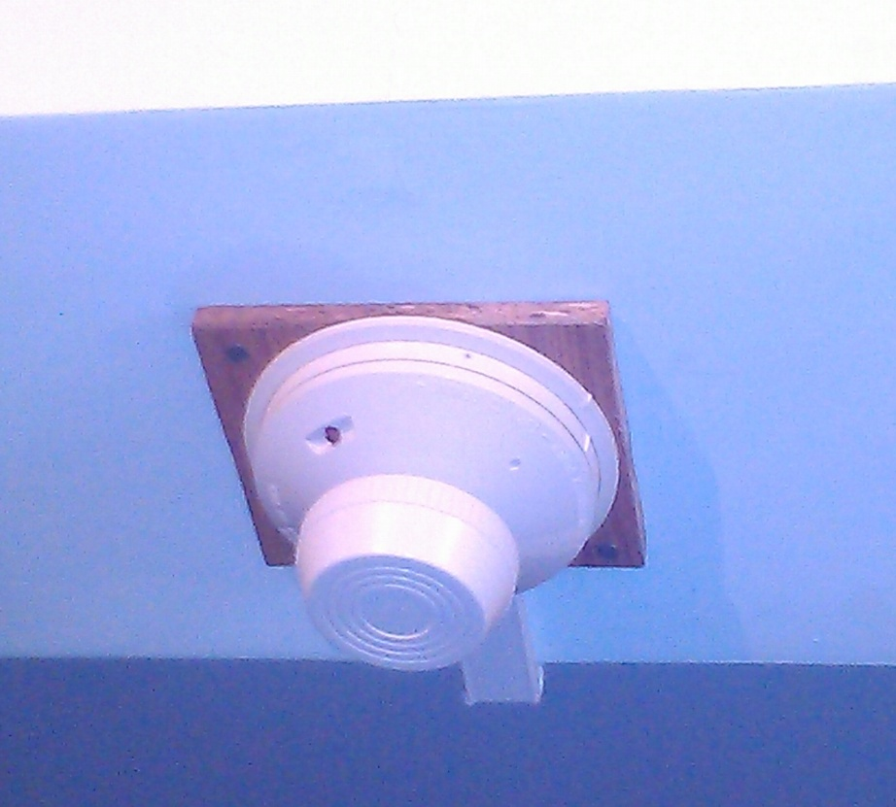
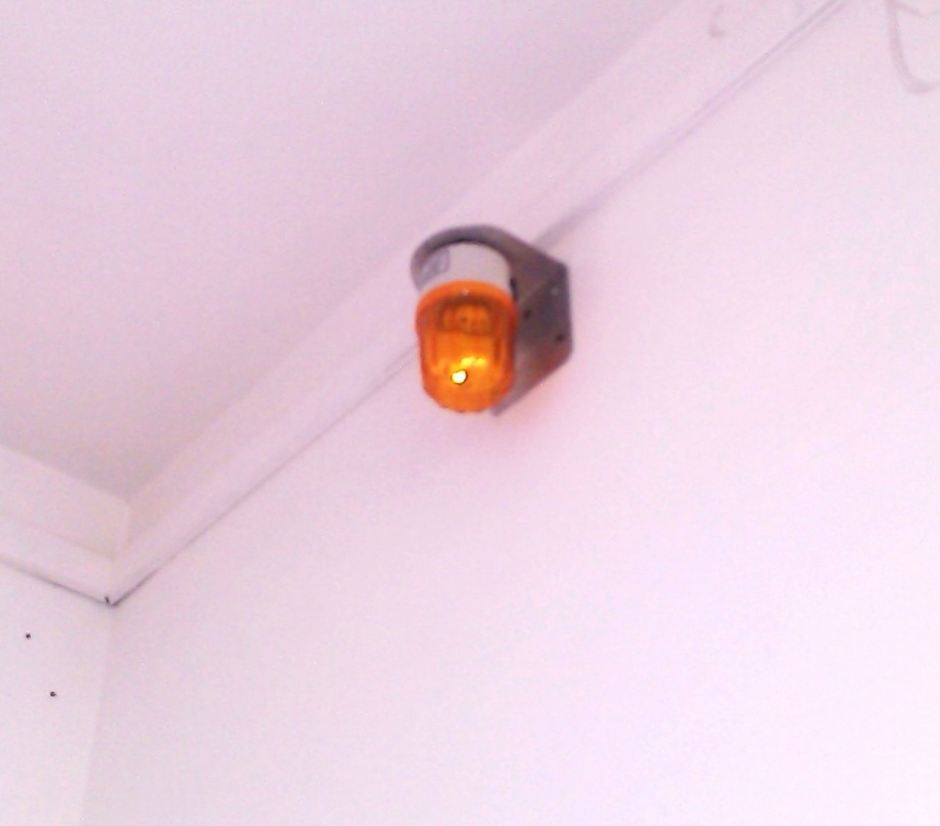
Installation and commissioning of Smoke and
Fire Alarm System in the Telemetry Lab.
Up-gradation activities of Telemetry System are in progress in the Lab. Various tests are in progress and system is running for 24 Hr. (day & night) including communication with other system and sub-systems in the other Lab as well as antenna shells. Over temperature, smoke and fire are very critical inside the Lab. Therefore, I have successfully installed and commissioned Electronics Safety System in the Telemetry Lab.
Very soon we are extending this Electronics Safety System to the other Labs.

Slide 42
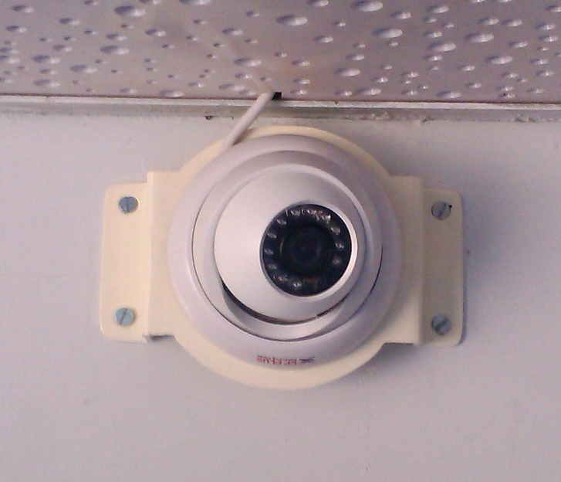
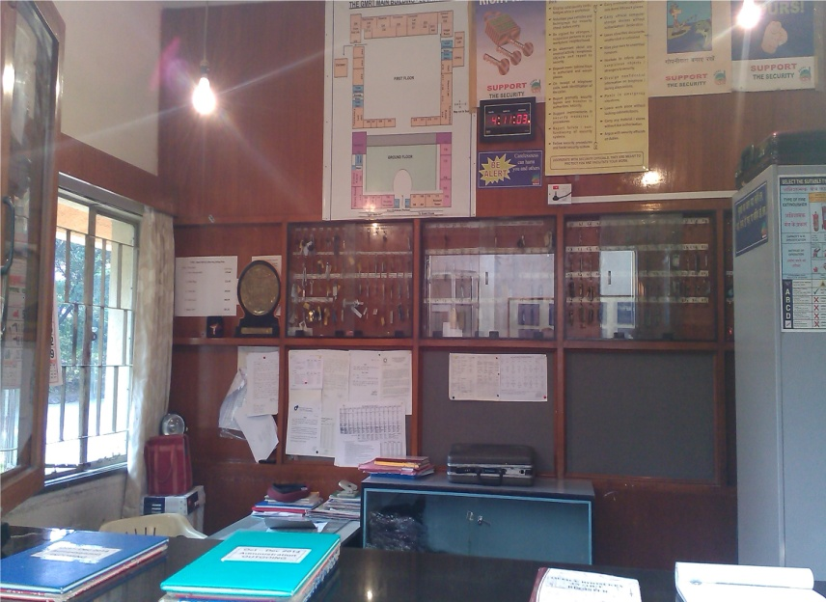
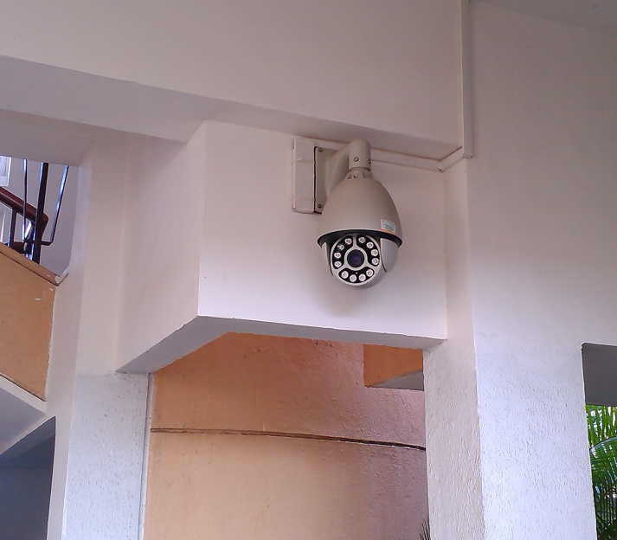
Installation and commissioning of Video Surveillance
System at the GMRT CEB.
We have successfully installed this system at the GMRT CEB . It is IP based video surveillance system. Therefore, it is possible to monitor and record the video information even remotely (anytime and anywhere).

Slide 43
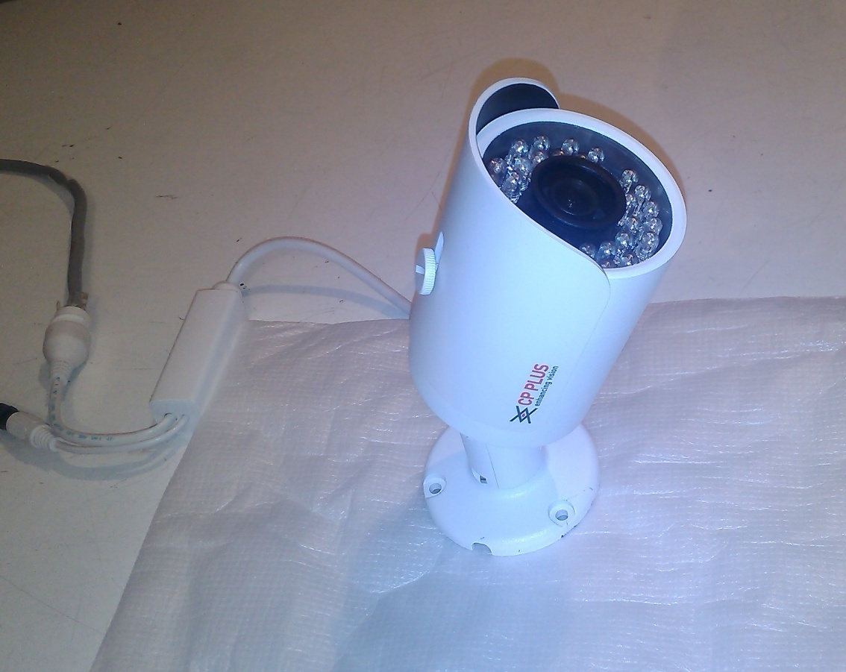
Installation and commissioning of Video Surveillance
System at 15 metre antenna at NCRA.
We have successfully installed this system at 15 metre antenna at NCRA. It is an IP based video surveillance system. Therefore, it is possible to monitor and record the video information even remotely (anytime and anywhere).

Slide 44
Ongoing Activities of Electronics Safety System:
Installation Electronics Safety System in the High Lift Platform (HPL)
Installation of Video Surveillance System at the GMRT Main Gate and Reception of GMRT Housing Colony.
Installation of Smoke and Fire Alarm System in the GMRT Labs (Servo, Baseband, Corr. Lab and Jog shed Lab)

Slide 45
GCC and Control Room Activity
I am regularly attaining GCC meeting/Control Room for monitoring overall health of all GMRT antenna.
Daily visit and short meeting in the Control Room with Operators on duty to study and understand the various problems relating to antenna counts and signal quality and taking care for further actions. Apart from this I am talking personally to all the Operators of the Control Room about their night shift duty while preparing duty schedule chart in order to maintain equal responsibility among them.
Weekly co-ordination meeting on Callsheets status and various important discussions for GMRT Operation so that maximum antenna should be available for GTAC.
I am attaining Plan meeting for discussion and progress in designing, development and up gradations of M&C hardware and software, Telemetry and Sentinel system.

Slide 46
Other Responsibilities
1. Apart from regular GMRT activities, I am also actively involved in the selection committee for recruitment of new man power requirement of GMRT.
2. I am also part of Library committee.

